Slide 1



Slide 2


What’s in the bag?

Slide 3


Slide 4



‘God does not see the same way people see.
People look at the outside of a person,
but the Lord looks at the heart.’
(1 Samuel 16:7 ICB)

Slide 5
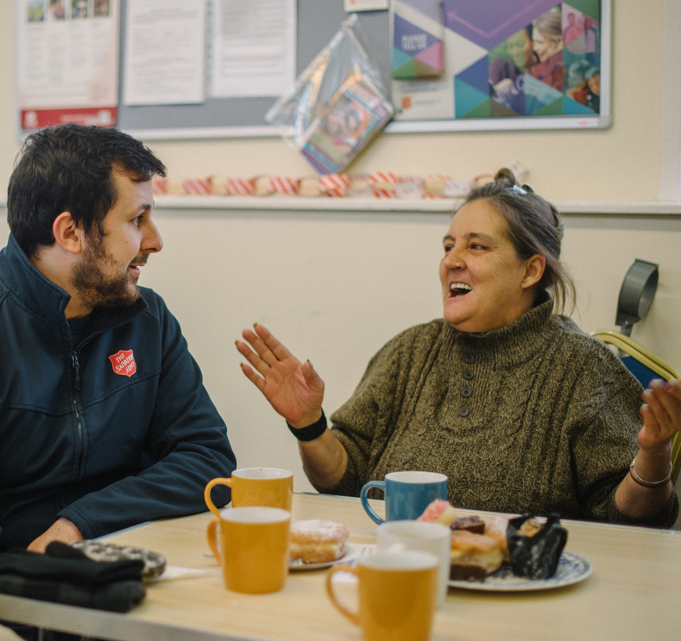
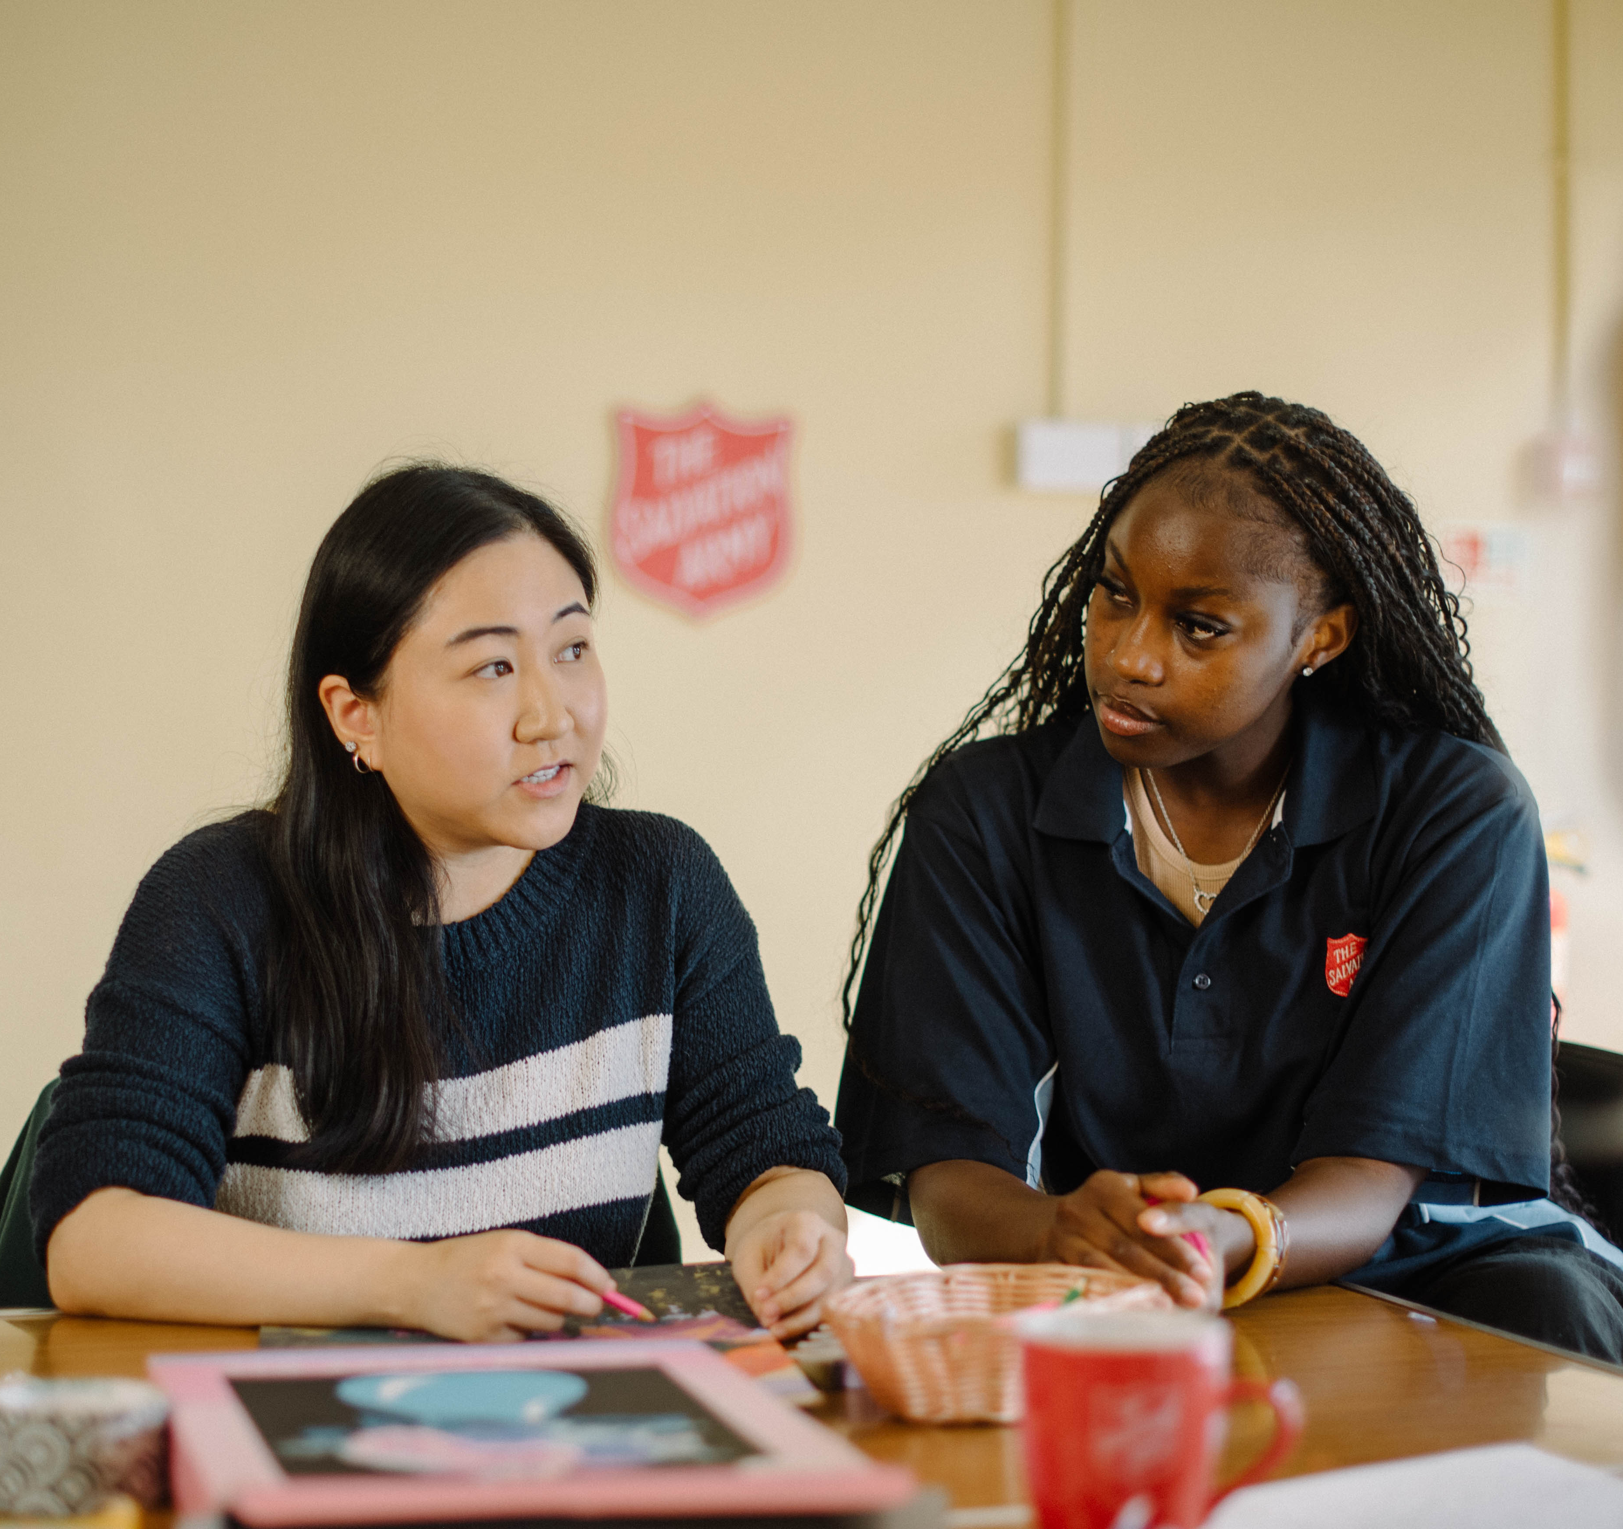
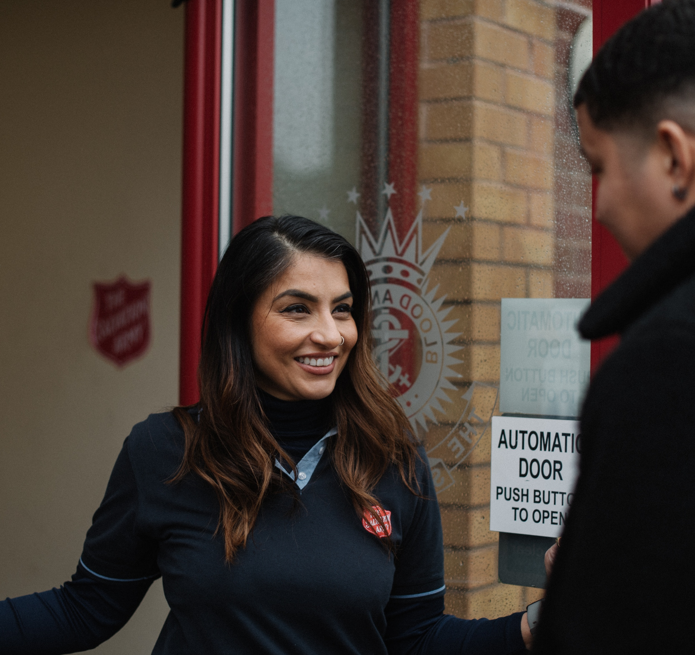
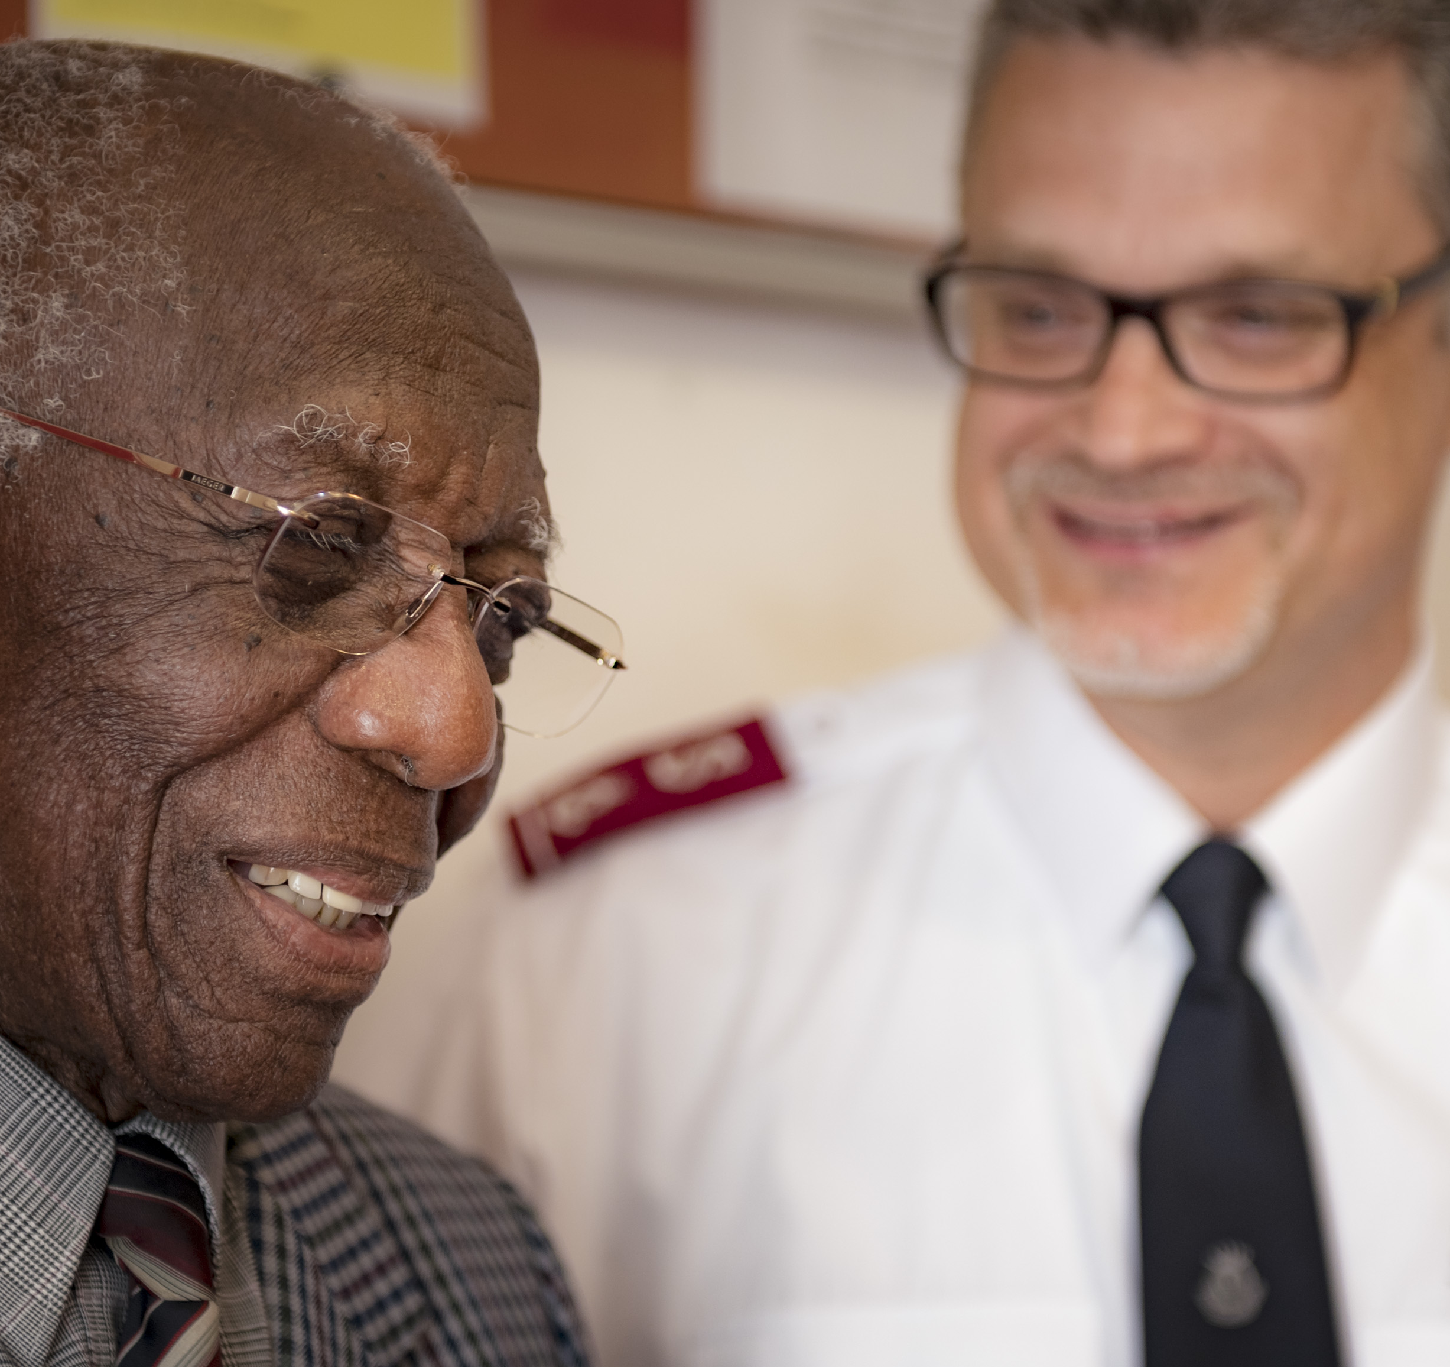
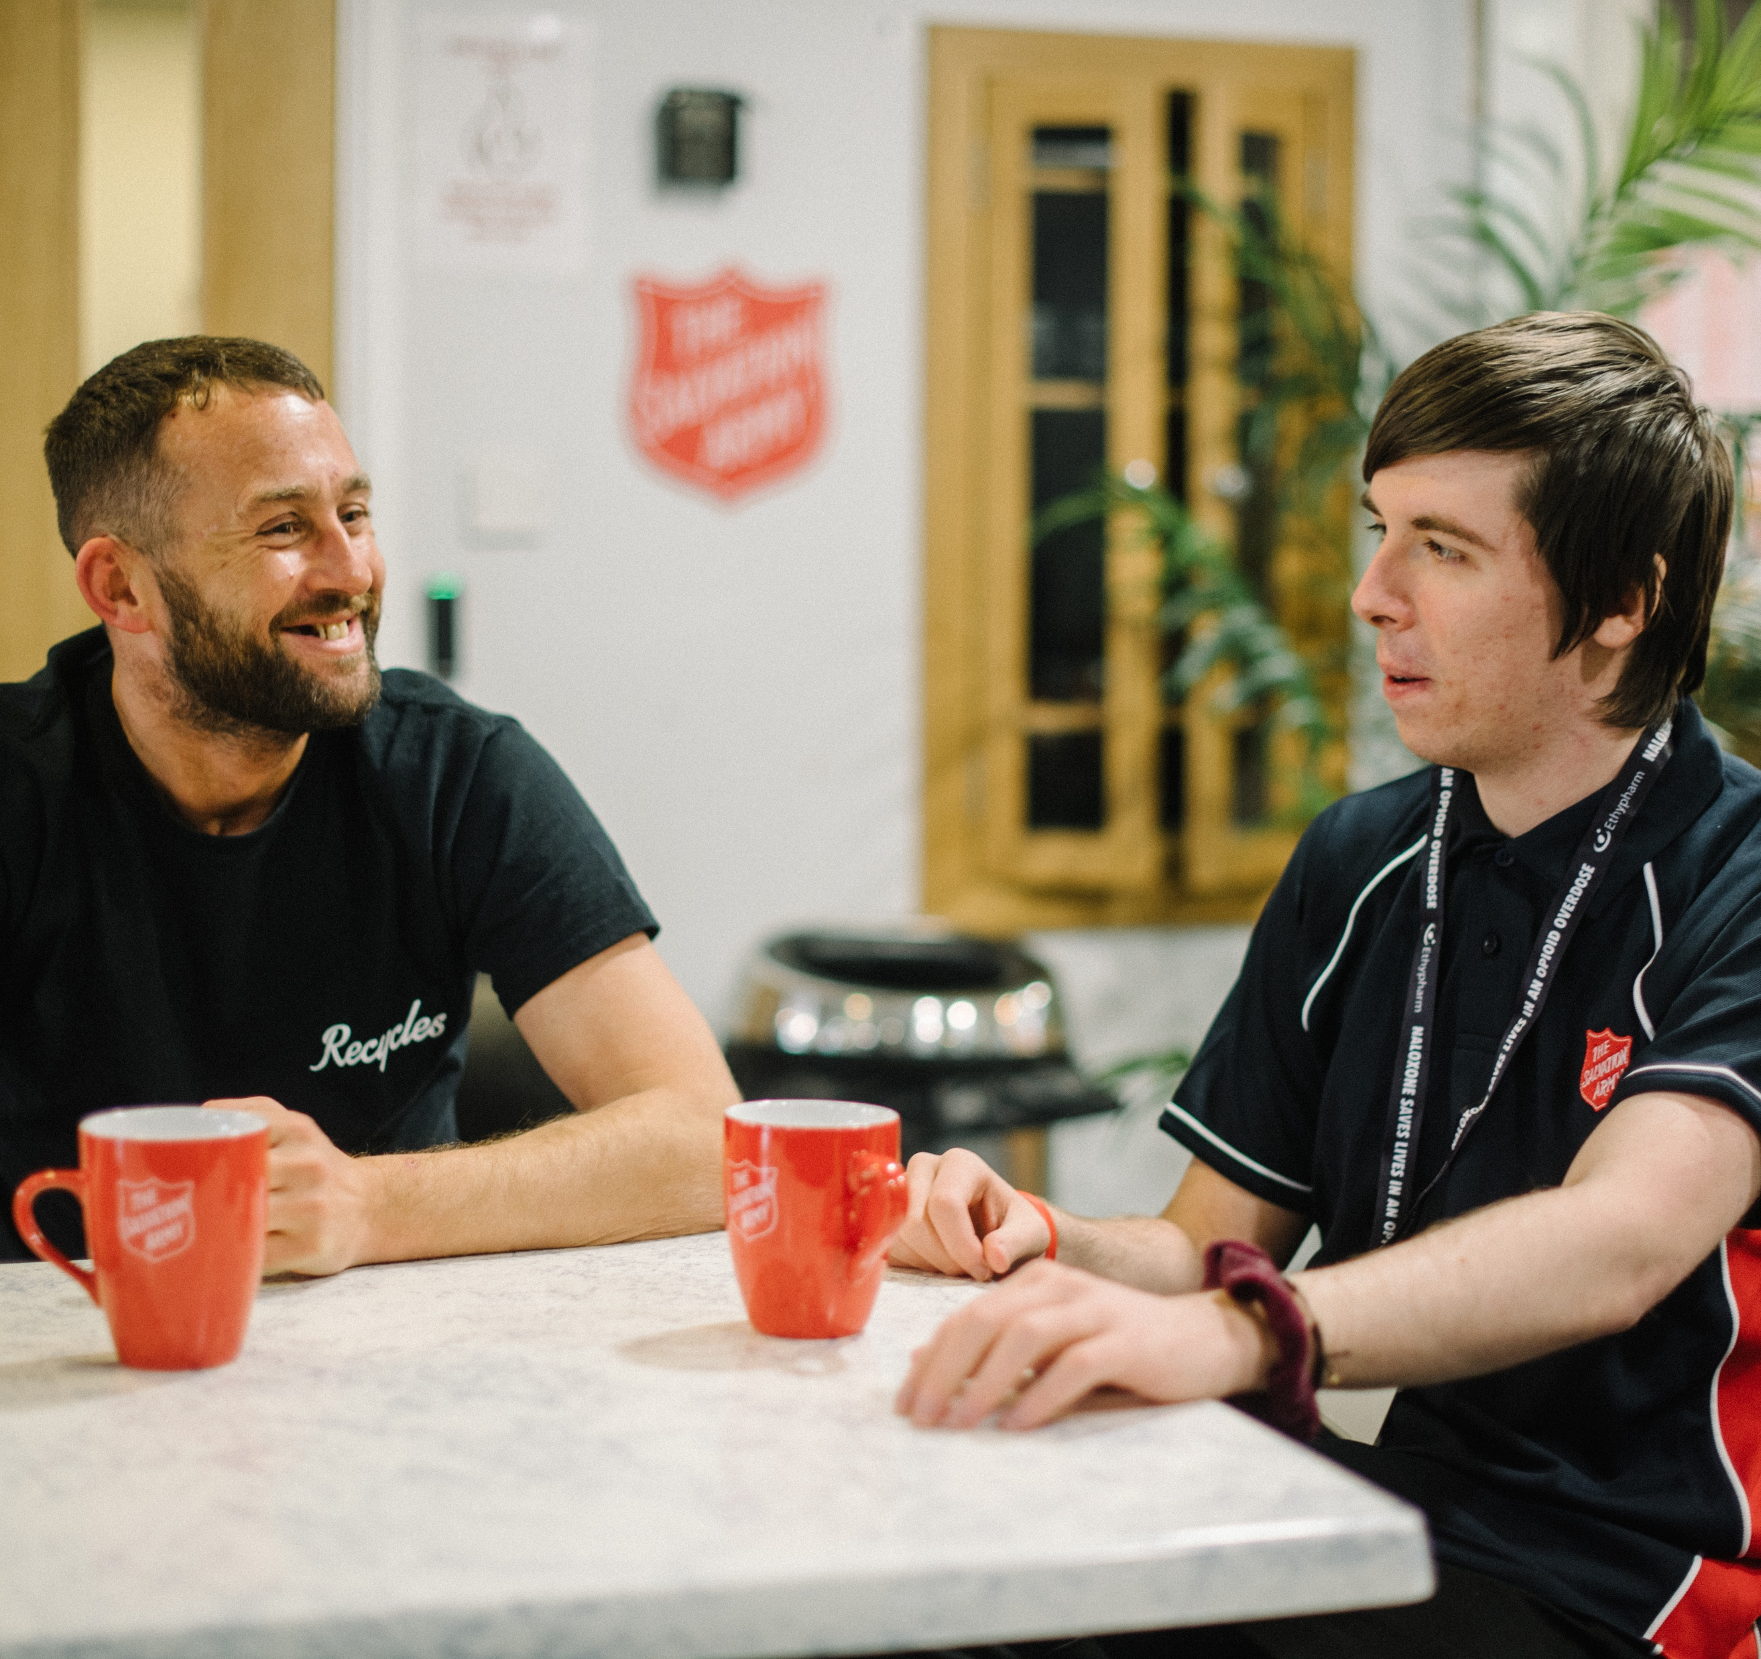

Treating everyone with respect

Slide 6
[name of local corps]
[Add an image]}

Slide 7

Thank you for helping others

Slide 8



What can I do?

