Slide 1
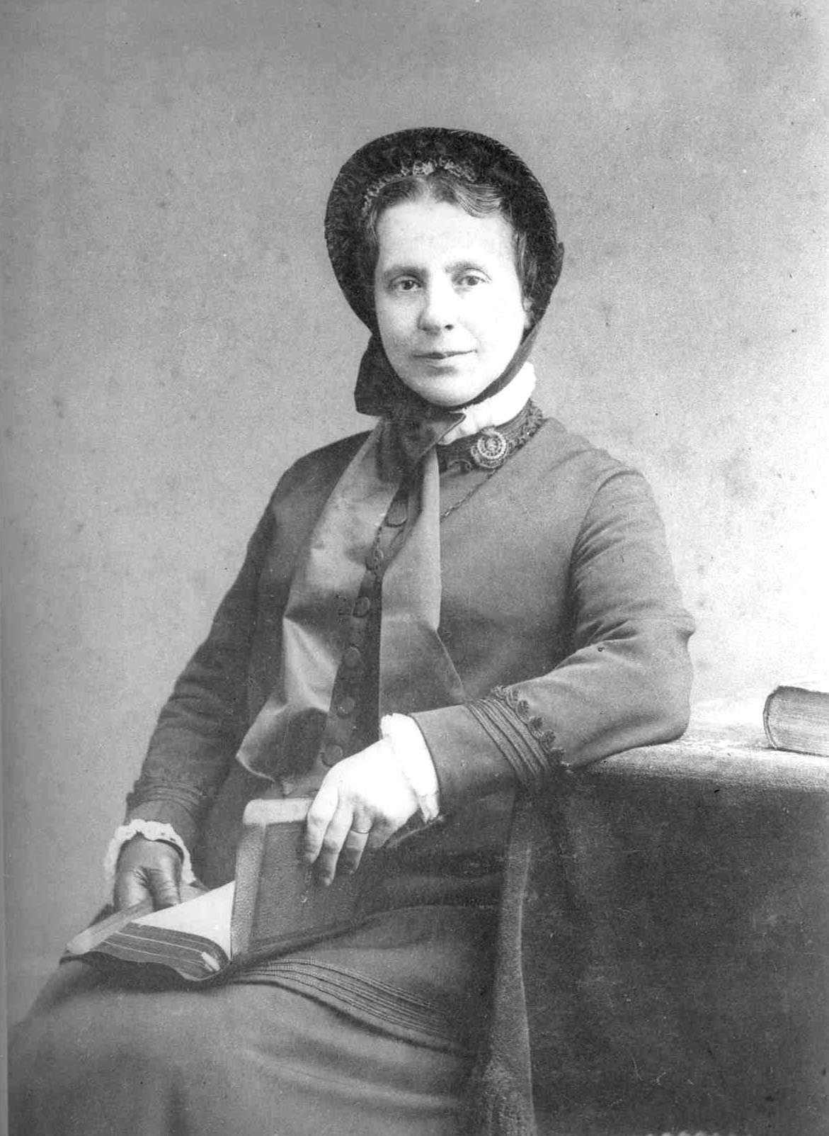

What did you enjoy the most?
What surprised you?
Schools and
Colleges
Unit

Slide 2

What do you know about Catherine Booth?

Slide 3


Victorian Women Facts
True or False?
What was it like to be a woman in Victorian times?

Slide 4
Learning Objectives
To investigate if Catherine Booth was a typical Victorian woman.
To consider how relevant Catherine’s story is today
To reflect on how Catherine may inspire others

Slide 5
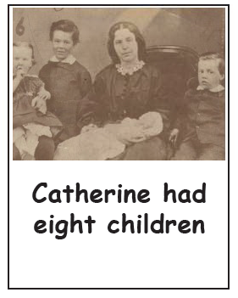
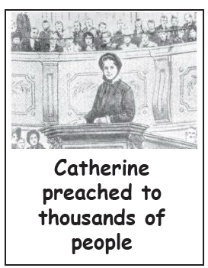

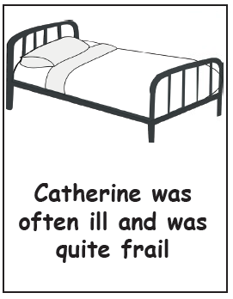


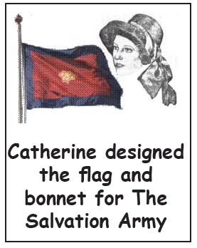
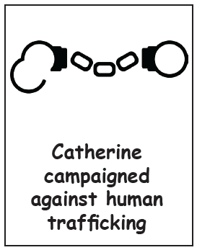
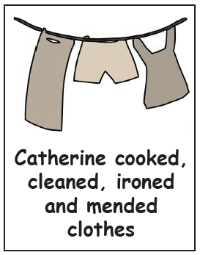
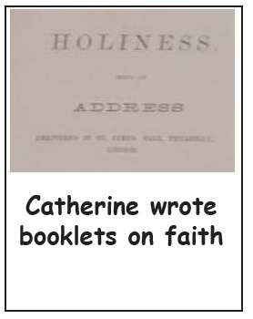
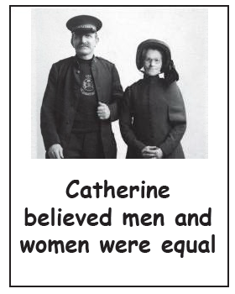

Slide 6

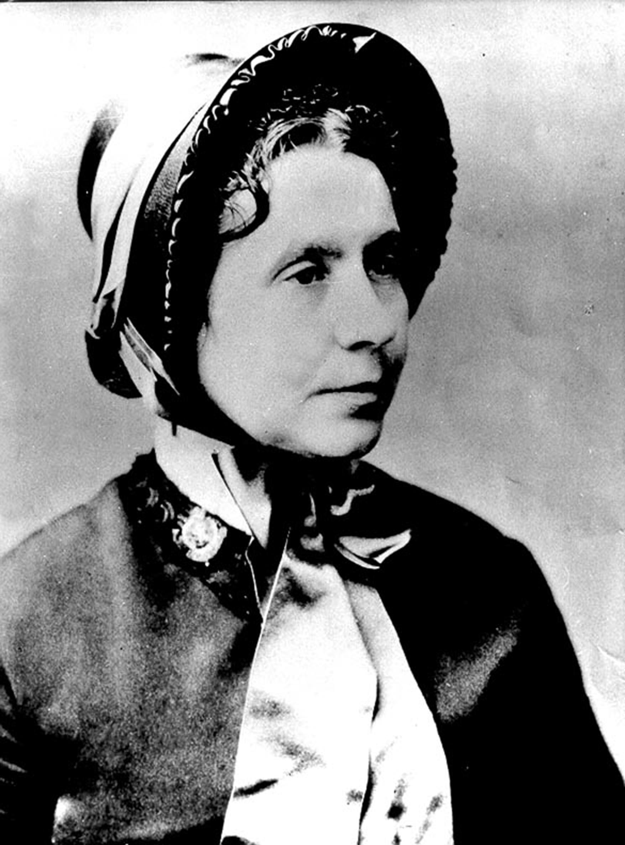
unexpected?
shocking?
surprising?
important?
most
impact?

Slide 7
Was Catherine a typical Victorian woman?
How did Catherine challenge people’s ideas of Victorian women?

Slide 8



Learning Objectives
To investigate if Catherine Booth was a typical Victorian woman.
To consider how relevant Catherine’s story is today

Slide 9



What new rules did Catherine make?
Decide on three with your talk partner
TIP
Be positive!
Think
CAN not CAN’T

Slide 10

Catherine’s New Rules!

Slide 11
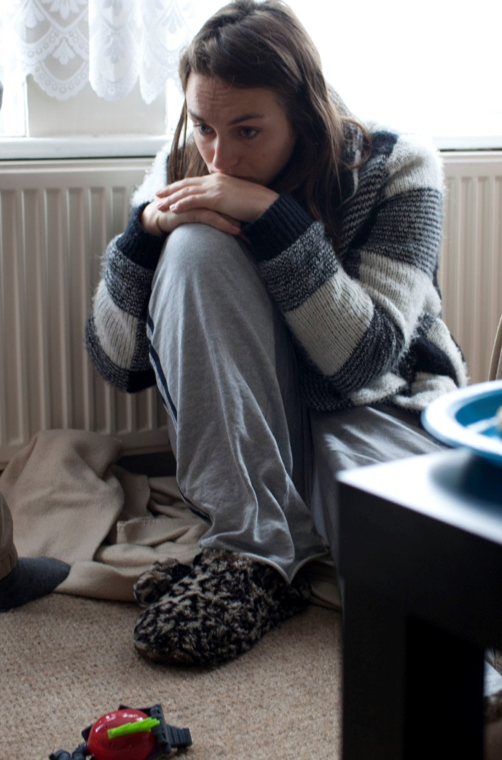



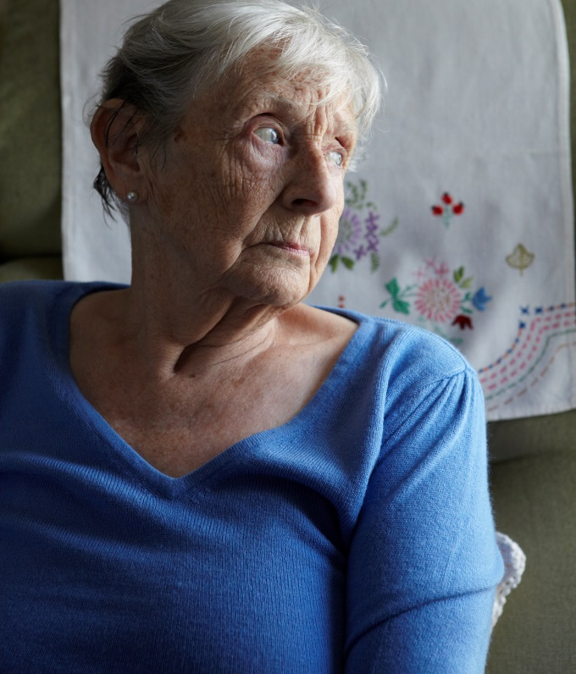

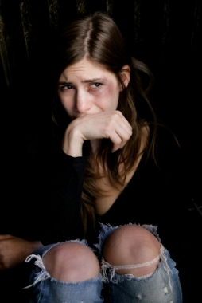
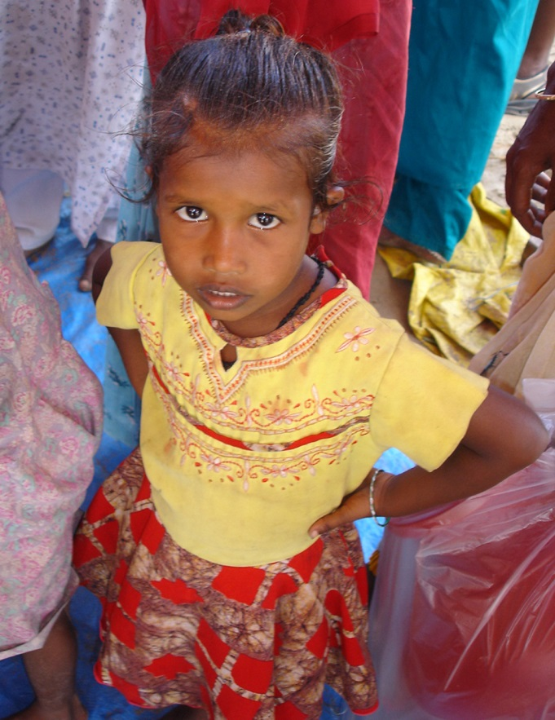
Are people still restricted today?

Slide 12


Choose a situation.
Draw a picture based on it.
Discuss the situation with your partner
What would Catherine say?

Slide 13
Is learning about Catherine Booth relevant for today?

Slide 14
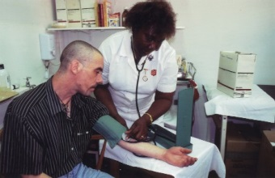
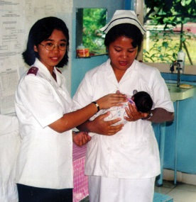
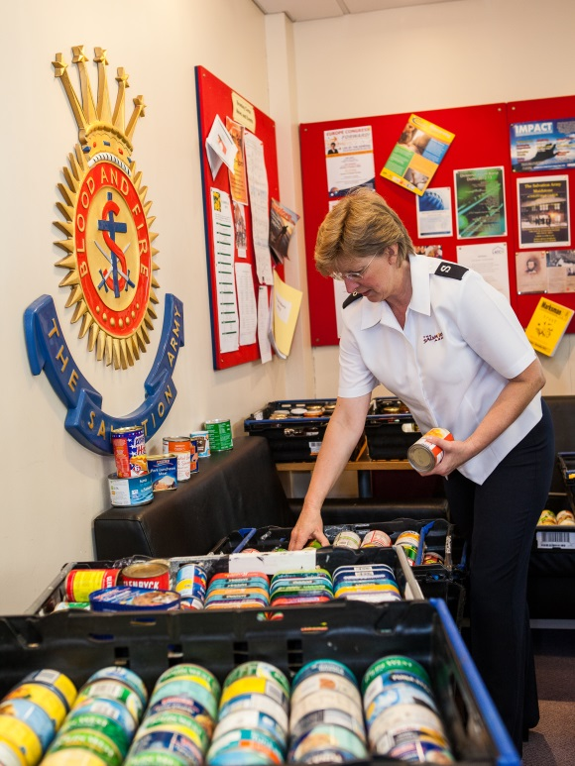
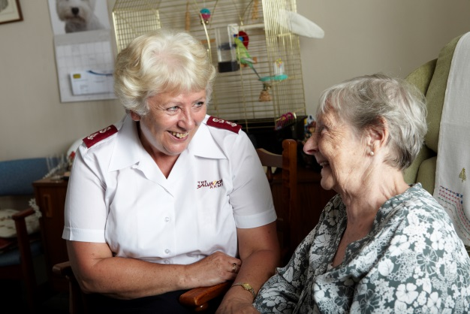
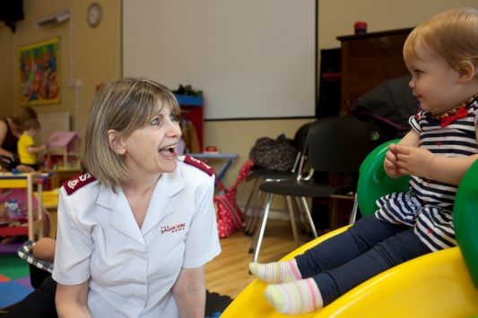
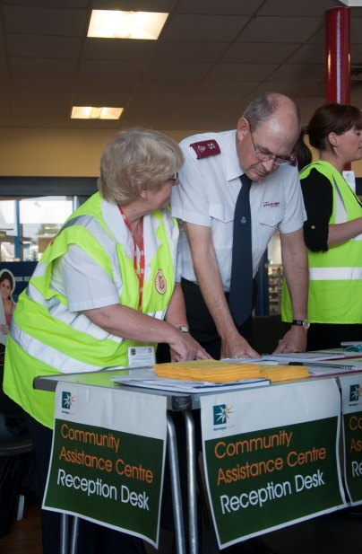


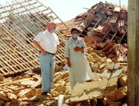
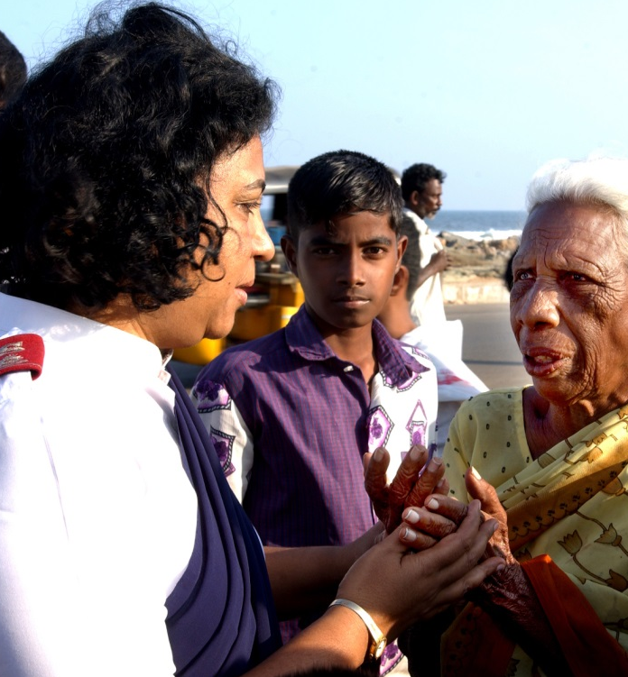
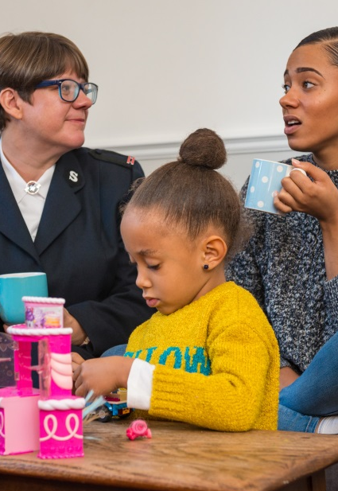
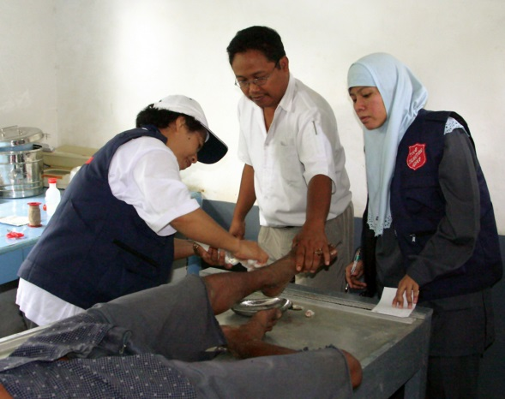
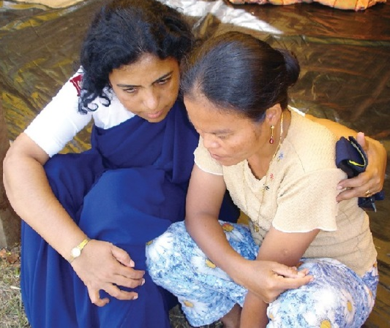

Slide 15
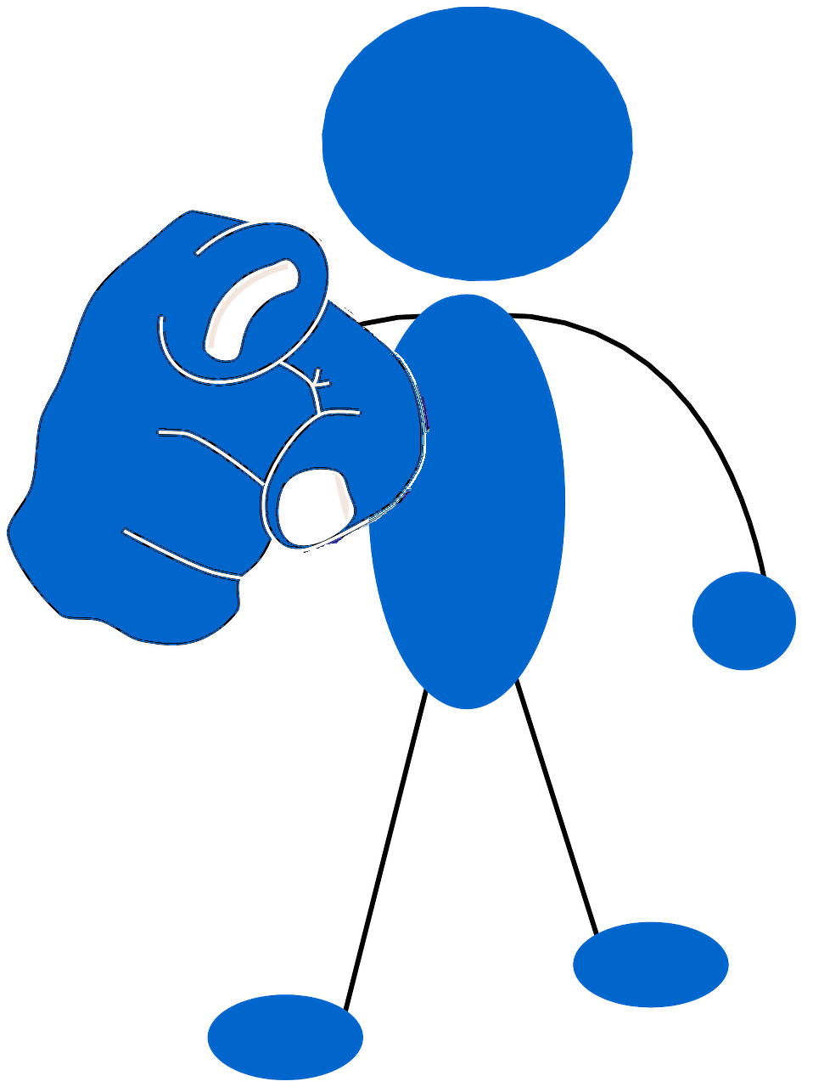
What will you do now?

Slide 16
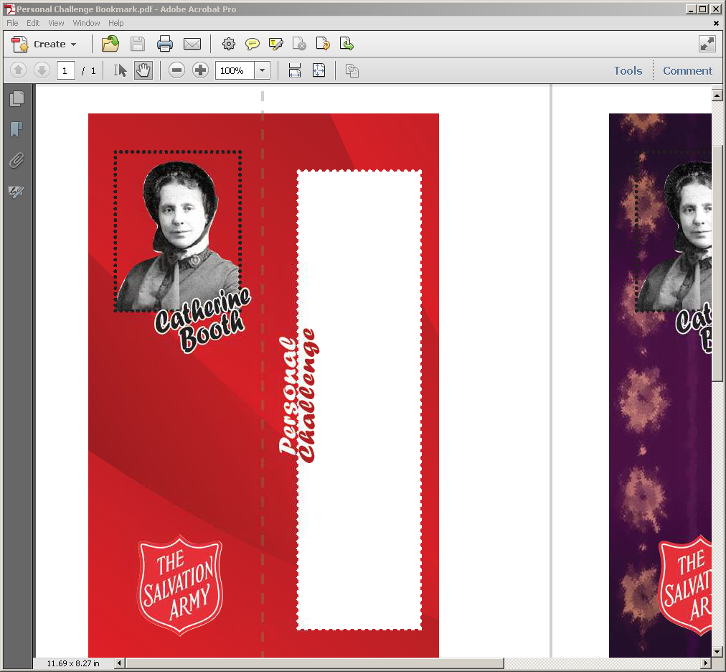



Personal Challenge

Slide 17
Learning Objectives
To investigate if Catherine Booth was a typical Victorian woman.
To consider how relevant Catherine’s story is today
To reflect on how Catherine may inspire others

Slide 18


Charades
Schools and
Colleges
Unit

